Slide 1
Decision trees
Marziyeh Mousavi
Introduction to datascience
Fall 2024

Slide 2
Decision tree
A decision tree uses a tree structure to represent a number of possible decision paths and an outcome for each path.
Decision trees have a lot to recommend them. They’re very easy to understand and interpret, and the process by which they reach a prediction is completely transparent. Unlike the other models we’ve looked at so far, decision trees can easily handle a mix of numeric (e.g., number of legs) and categorical (e.g., delicious/not delicious) attributes and can even classify data for which attributes are missing.

Slide 3
Decision Trees
At the same time, finding an “optimal” decision tree for a set of training data is computationally a very hard problem. (We will get around this bytrying to build a good-enough tree rather than an optimal one, although for large datasets this can still be a lot of work.) More important, it is very easy (and very bad) to build decision trees that are overfitted to the training data, and that don’t generalize well to unseen data. We’ll look at ways to address this.

Slide 4
Decision tree
Most people divide decision trees into classification trees (which produce categorical outputs) and regression trees (which produce numeric outputs). In this chapter, we’ll focus on classification trees, and we’ll work through the ID3 algorithm for learning a decision tree from a set of labeled data, which should help us understand how decision trees actually work. To make things simple, we’ll restrict ourselves to problems with binary outputs like “Should I hire this candidate?” or “Should I show thiswebsite visitor advertisement A or advertisement B?” or “Will eating thisfood I found in the office fridge make me sick?”

Slide 5
Example of a decision tree
Suppose that you play a game of twenty Questions:
I am thinking of an animal.”
“Does it have more than five legs?”
“No.”
“Is it delicious?”
“No.”
“Does it appear on the back of the Australian five-cent coin?”
“Yes.”
“Is it an echidna?”
“Yes, it is!”

Slide 6
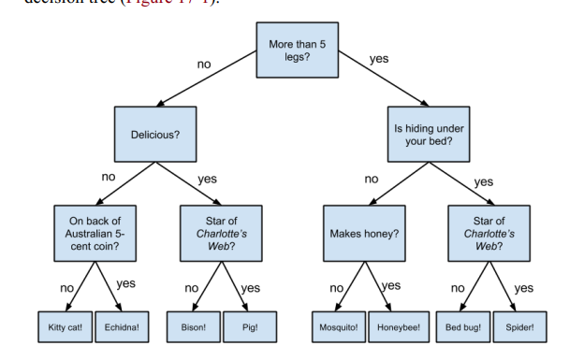
Example of a decision tree
“Not more than 5 legs” → “Not delicious” → “On the 5-cent coin” →“Echidna!”
This is the path in the tree which leads to the answer.

Slide 7
Entropy
In order to build a decision tree, we will need to decide what questions to ask and in what order. At each stage of the tree there are some possibilities we’ve eliminated and some that we haven’t. After learning that an animal doesn’t have more than five legs, we’ve eliminated the possibility that it’s a grasshopper. We haven’t eliminated the possibility that it’s a duck. Each possible question partitions the remaining possibilities according to its answer.

Slide 8
Entropy
Ideally, we’d like to choose questions whose answers give a lot of information about what our tree should predict. If there’s a single yes/no question for which “yes” answers always correspond to True outputs and “no” answers to False outputs (or vice versa), this would be an awesome question to pick. Conversely, a yes/no question for which neither answer gives you much new information about what the prediction should be is probably not a good choice.

Slide 9
Entropy
We capture this notion of “how much information” with entropy. You have probably heard this term used to mean disorder. We use it to represent the uncertainty associated with data. Imagine that we have a set S of data, each member of which is labeled as belonging to one of a finite number of classes C1, ..., Cn. If all the data points belong to a single class, then there is no real uncertainty, which means we’d like there to be low entropy. If the data points are evenlyspread across the classes, there is a lot of uncertainty and we’d like there to be high entropy

Slide 10
Entropy Formulation
In math terms, if pi is the proportion of data labeled as class ci, we define the entropy as:
with the (standard) convention that 0 log 0 = 0.

Slide 11

The Entropy of a Partition
Mathematically, if we partition our data S into subsets S1, ..., Sm containing proportions q1, ..., qm of the data, then we compute the entropy of the partition as a weighted sum:

Slide 12
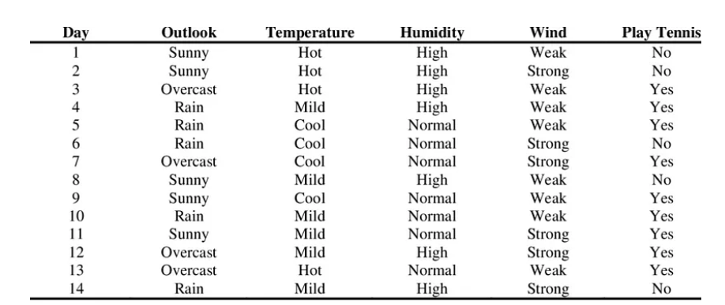
Building a tree using Entropy
This is the playing tennis dataset .Here based on the condition we decide if we want to play tennis on a particular day or not.

Slide 13
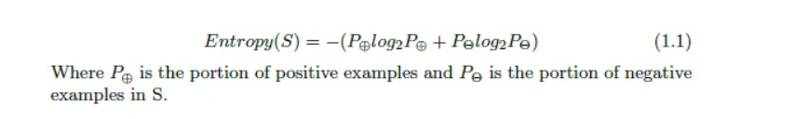
Building a tree using Entropy
This is how we calculate entropy in this dataset for each attribute

Slide 14
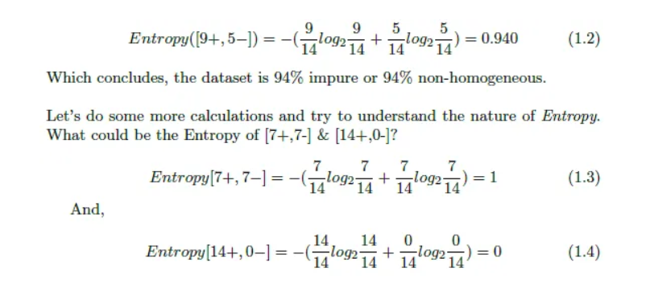
Building a tree using Entropy
First we calculate the entropy of our dataset.

Slide 15
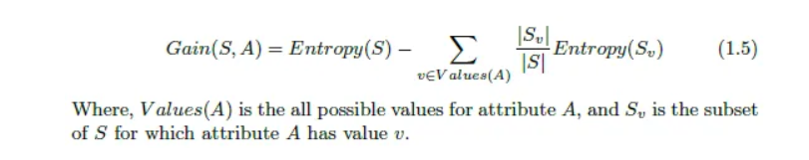
Building a tree using Entropy
This is the gain formula which we use later to build the tree.

Slide 16
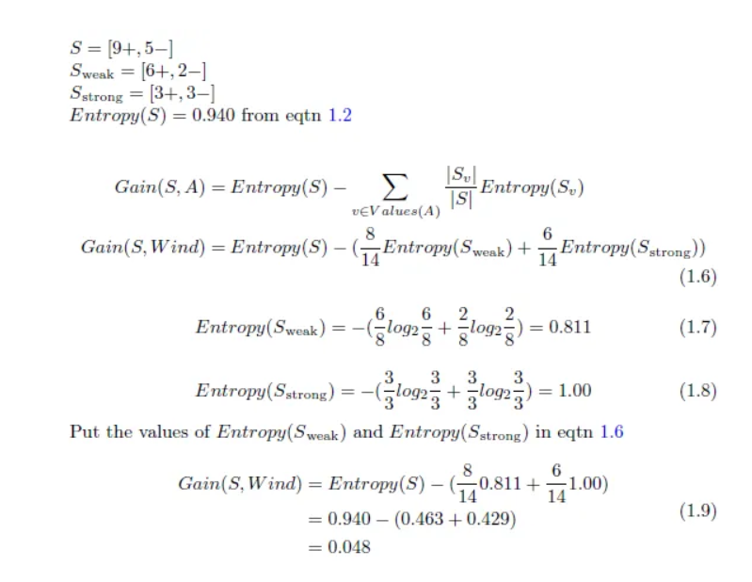
Building a tree using Entropy
Let’s calculate the entropy and information gain for wind attribute.

Slide 17
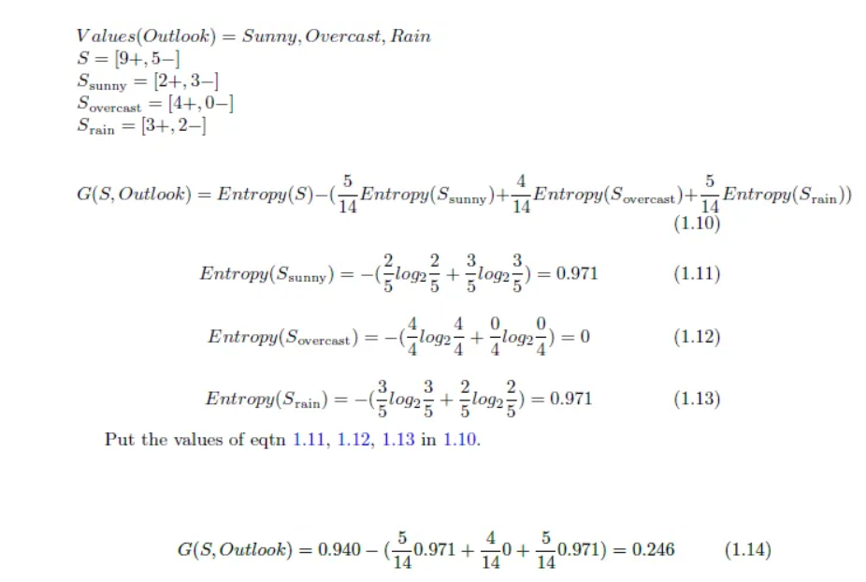
Building a tree using Entropy
Let’s calculate the entropy and information gain for outlook attribute.

Slide 18
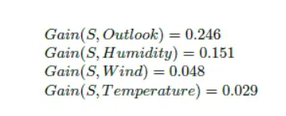
Building a tree using Entropy
We continue the Process and we gain these numbers for information gain

Slide 19
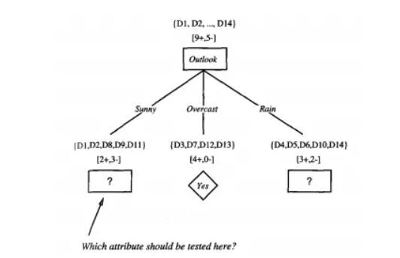
Building a tree using Entropy
Remember, the main goal of measuring information gain is to find the attribute which is most useful to classify training set. Our ID3 algorithm will use the attribute as it’s root to build the decision tree. Then it will again calculate information gain to find the next node. As far as we calculated, the most useful attribute is “Outlook” as it is giving us more information than others. So, “Outlook” will be the root of our tree

Slide 20
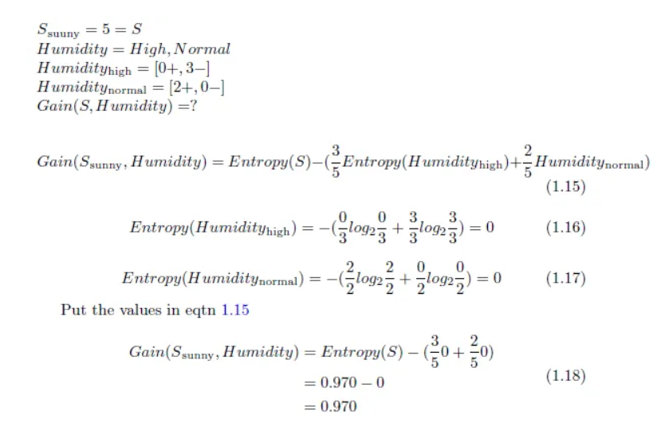
Building a tree using Entropy
training examples are sorted to the corresponding descendant nodes. The Overcast descendant has only positive instances and therefore becomes a leaf node with classification Yes. For other two nodes, the question again arises which attribute should be tested? These two nodes will be further expanded by selecting the attributes with the highest information gain relative to the new subset of examples. Let’s find the attribute that should be tested at the Sunny descendant.

Slide 21
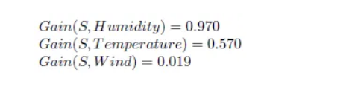
Building a tree using Entropy
We can now measure the information gain of Temperature and Wind by following the same way we measured Gain(S, Humidity). Finally, we will get:

Slide 22
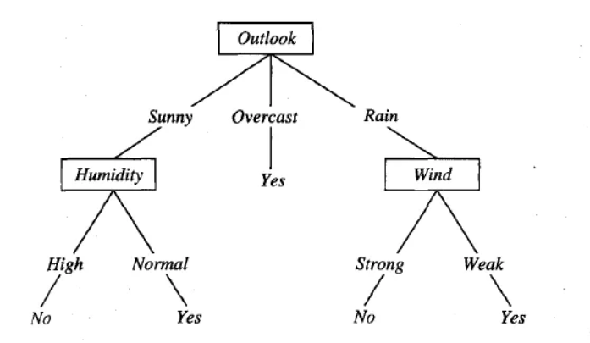
Building a tree using Entropy
So Humidity gives us the most information at this stage. The node after “Outlook” at Sunny descendant will be Humidity. The High descendant has only negative examples and the Normal descendant has only positive examples. So both of them become the leaf node and can not be furthered expanded. If we expand the Rain descendant by the same procedure we will see that the Wind attribute is providing most information. I am leaving this portion for the readers to do the calculation on their own. Therefore our final decision tree looks like This:

Slide 23
Implementation in python
Using the Iris dataset, we can construct a tree as follow:
from sklearn.datasets import load_iris
from sklearn import tree
iris = load_iris()
X, y = iris.data, iris.target
clf = tree.DecisionTreeClassifier()
clf = clf.fit(X, y)

Slide 24
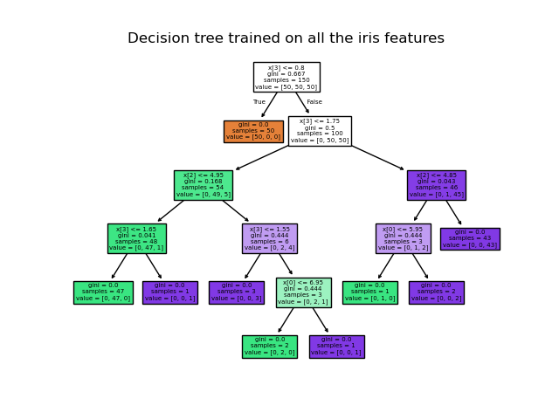
Implementation in python
Once trained, you can plot the tree with the plot_tree function:

Slide 25
Random Forest
Given how closely decision trees can fit themselves to their training data, it’s not surprising that they have a tendency to overfit. One way of avoiding this is a technique called random forests, in which we build multiple decision trees and combine their outputs. If they’re classification trees, we might let them vote; if they’re regression trees, we might average their predictions.

Slide 26
Random Forest-ensemble learning
Ensemble learning models work just like a group of diverse experts teaming up to make decisions – think of them as a bunch of friends with different strengths tackling a problem together. Picture it as a group of friends with different skills working on a project. Each friend excels in a particular area, and by combining their strengths, they create a more robust solution than any individual could achieve alone.

Slide 27
Random Forest-ensemble learning
Similarly, in ensemble learning, different models, often of the same type or different types, team up to enhance predictive performance. It’s all about leveraging the collective wisdom of the group to overcome individual limitations and make more informed decisions in various machine learning tasks. Some popular ensemble models include- XGBoost, AdaBoost, LightGBM, Random Forest, Bagging, Voting etc.

Slide 28
Random Forest-bagging and boosting
Bagging is an ensemble learning model, where multiple week models are trained on different subsets of the training data. Each subset is sampled with replacement and prediction is made by averaging the prediction of the week models for regression problem and considering majority vote for classification problem.

Slide 29
Random Forest-bagging and boosting
Boosting trains multiple based models sequentially. In this method, each model tries to correct the errors made by the previous models. Each model is trained on a modified version of the dataset, the instances that were misclassified by the previous models are given more weight. The final prediction is made by weighted voting.

Slide 30
Algorithm for Random Forest
Step 1: Select random K data points from the training set.
Step 2:Build the decision trees associated with the selected data points(Subsets).
Step 3:Choose the number N for decision trees that you want to build.
Step 4:Repeat Step 1 and 2.
Step 5: For new data points, find the predictions of each decision tree, and assign the new data points to the category that wins the majority votes.

Slide 31
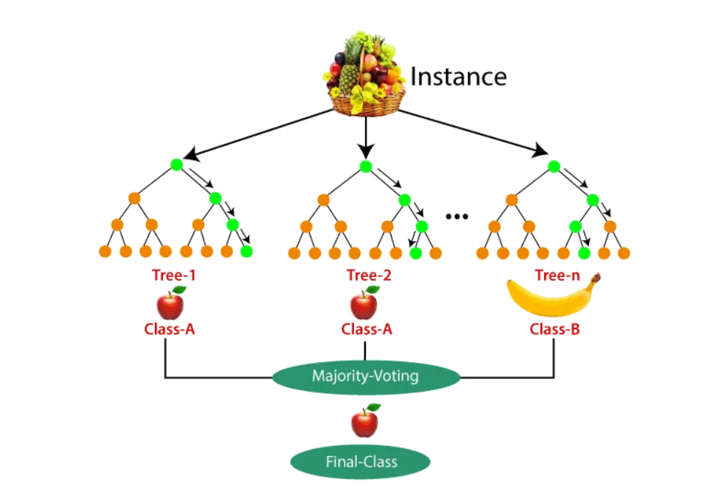
Example

Slide 32
Implementation in python
import pandas as pd
import numpy as np
# Modelling
from sklearn.ensemble import RandomForestClassifier
from sklearn.metrics import accuracy_score, confusion_matrix, precision_score, recall_score, ConfusionMatrixDisplay
from sklearn.model_selection import RandomizedSearchCV, train_test_split
from scipy.stats import randint
# Tree Visualisation
from sklearn.tree import export_graphviz
from IPython.display import Image
import graphviz

Slide 33
Implementation in python
# Split the data into features (X) and target (y)
X = bank_data.drop('y', axis=1)
y = bank_data['y']
# Split the data into training and test sets
X_train, X_test, y_train, y_test = train_test_split(X, y, test_size=0.2)

Slide 34
Implementation in python
rf = RandomForestClassifier()
rf.fit(X_train, y_train)
y_pred = rf.predict(X_test)
accuracy = accuracy_score(y_test, y_pred)
print("Accuracy:", accuracy)
One possible output:
Accuracy:0.888

Slide 35
Implementation in python
for i in range(3):
tree = rf.estimators_[i]
dot_data = export_graphviz(tree, feature_names=X_train.columns,filled=True,max_depth=2,impurity=False,proportion=True)
graph = graphviz.Source(dot_data)
display(graph)

Slide 36
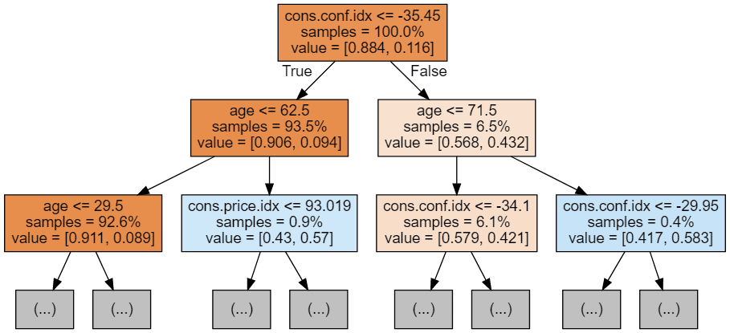
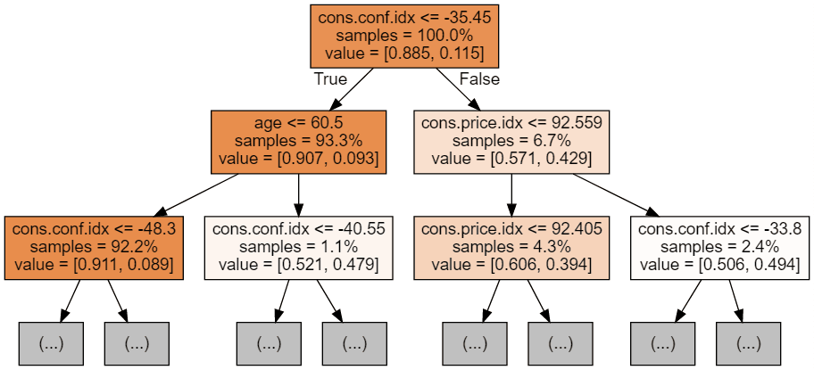
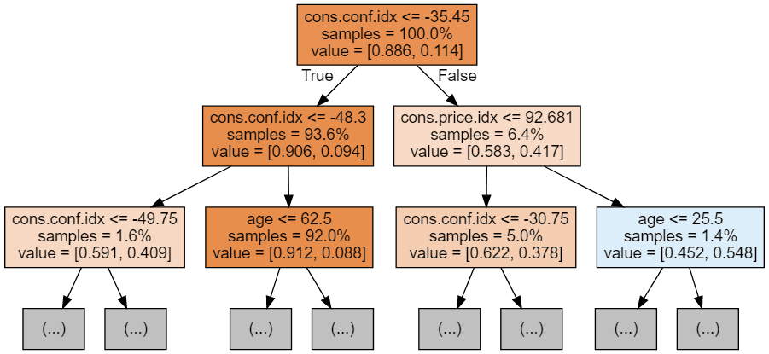
Implementation in python
Possible output

